Slide 1

Tackling Indigenous Smoking Workers Induction Pack
▶️ Play as slideshow to click links on slides

Slide 2






Induction Pack

Slide 3
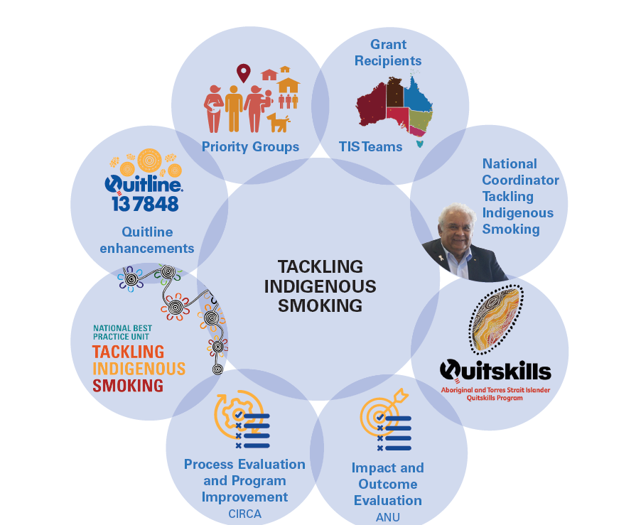

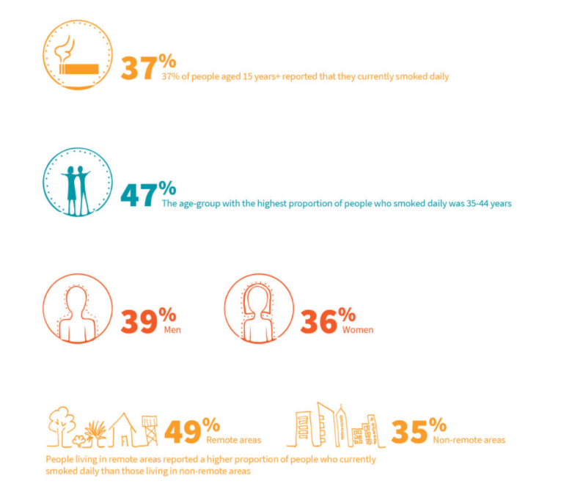

Background
About the TIS program
About NBPU TIS
Facts about smoking
Click on the links to learn more about the background of the Tackling Indigenous Smoking program and the National Best Practice Unit.

Slide 4
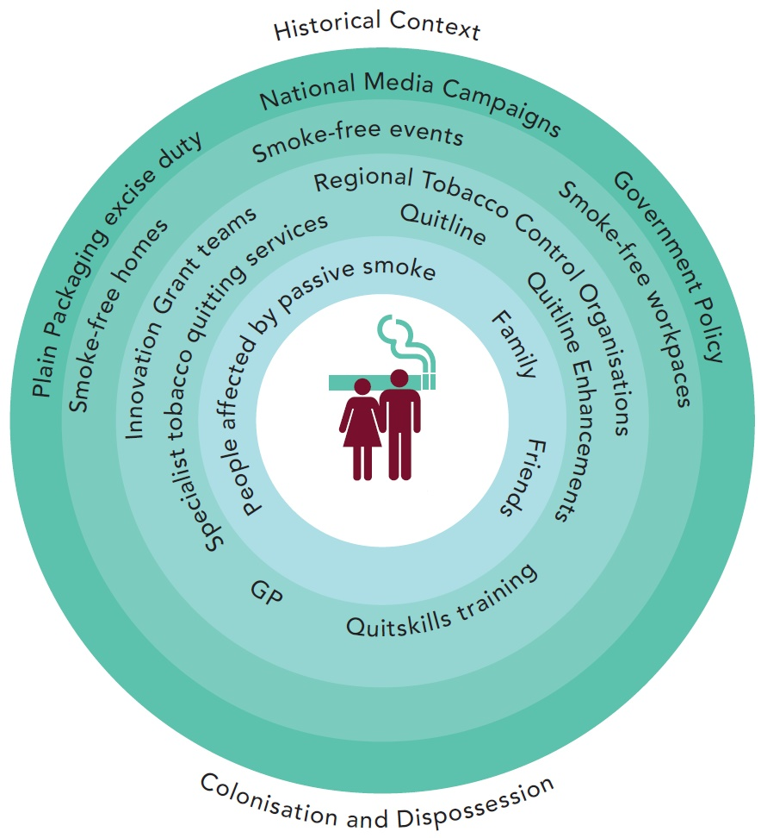
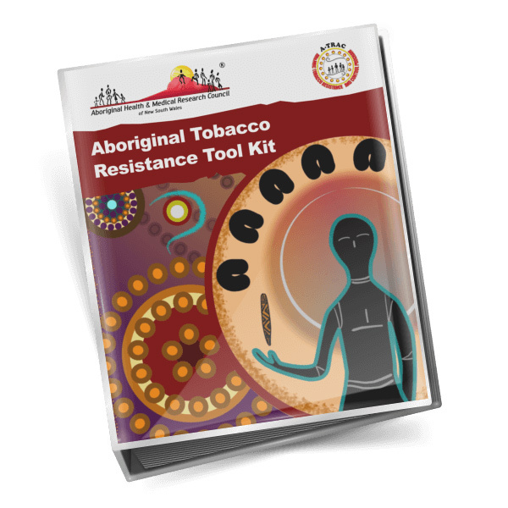
Planning
These links will provide you with information and tools to plan your TIS activities.
Planning
Planning tools

Slide 5
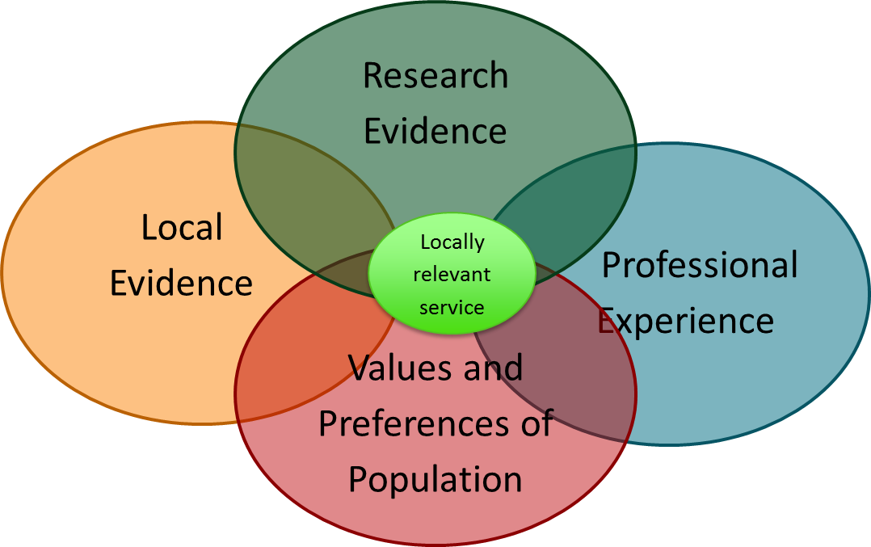
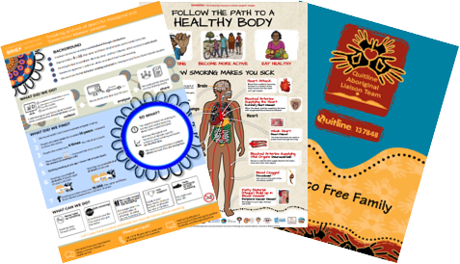
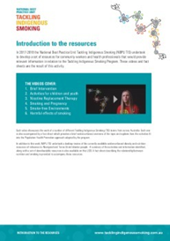

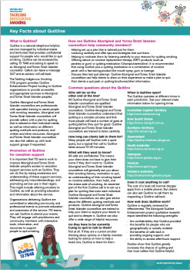

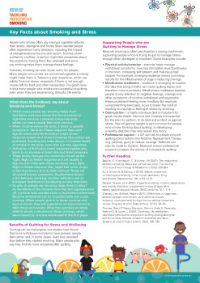




Activities
Explore
evidence-based activities for your TIS team via the links on this slide.
Choosing evidence-based activities
Resources to support activities
Smoke free environments
Smoking in pregnancy
Child and youth engagement
TIS teams working with NRT
Brief intervention
Harmful effects of smoking
Key facts about Quitline
Key facts about Quitskills
Key facts about smoking and stress
Key facts about e-cigarettes [infographic]
Key facts about e-cigarettes [factsheet]
Keys facts about social media [infographic]
Key facts about social media [factsheet]

Slide 6
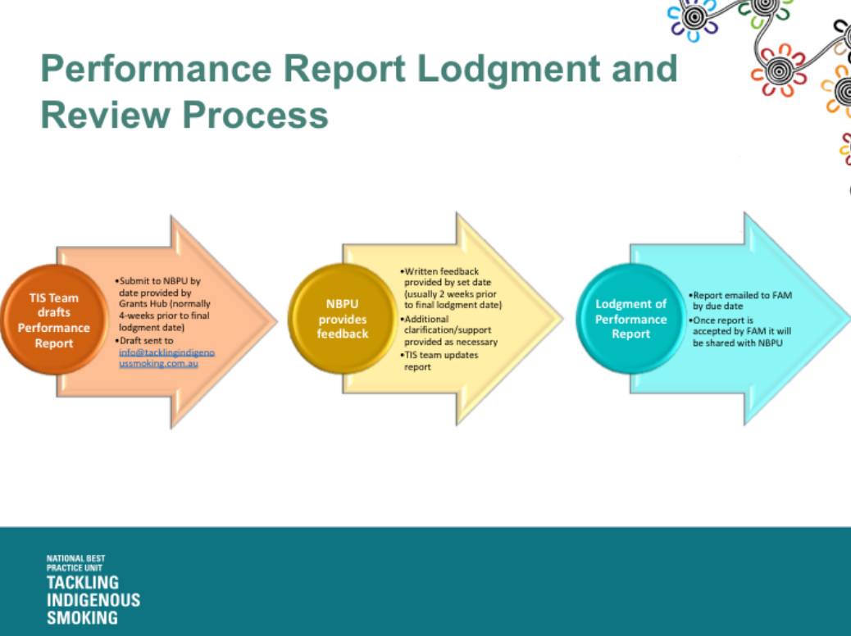
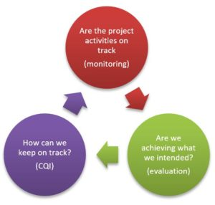
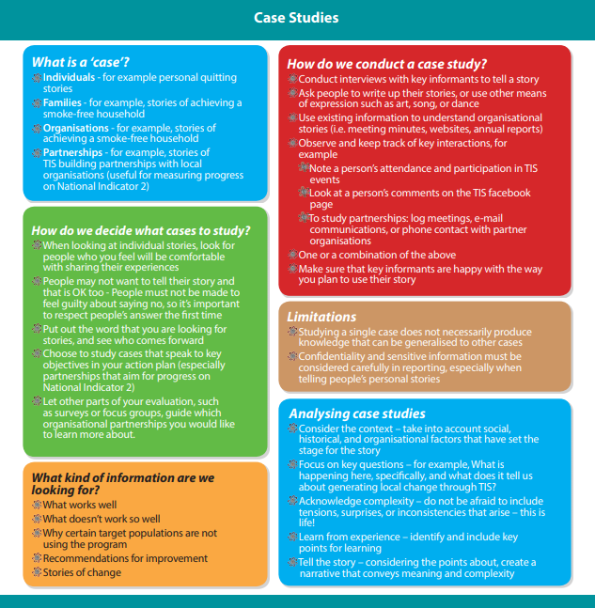
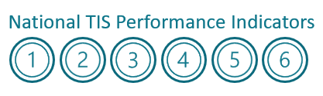
Reporting and Monitoring & Evaluation
Reporting on your TIS activities (including templates)
Monitoring and evaluation
Resources to monitor and evaluate your program
These links will provide you with the tools to monitor and evaluate your program, and information on how to report on your TIS activities.
National TIS Performance Indicators

Slide 7



Development Opportunities
Training
Events
Funding
Click on the links above to find out about personal and program development opportunities.
The NBPU TIS regularly hosts training days and jurisdictional workshops - it is important that you attend these.

