Slide 1
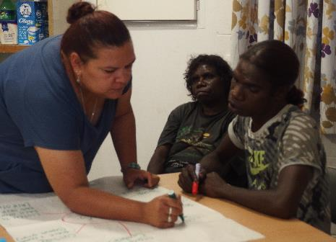
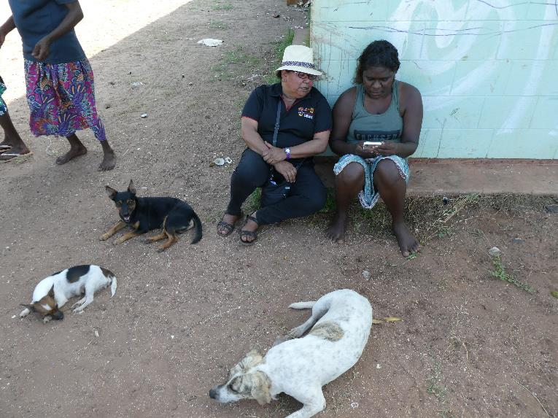
Tammy Abbott and Sharon Forrester Senior Researchers

Slide 2
How the Aboriginal Community Researcher (or ACR) program can help TIS teams

Slide 3
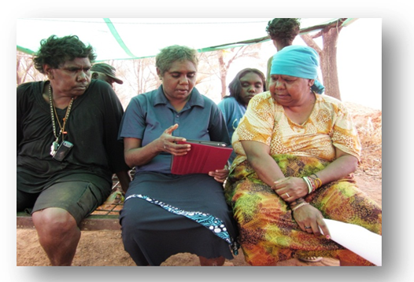
Other methods for generating ideas
Action learning sets
Participatory action research
Brainstorming
Mind mapping
Sector gap analysis
Asset pentagons

Slide 4
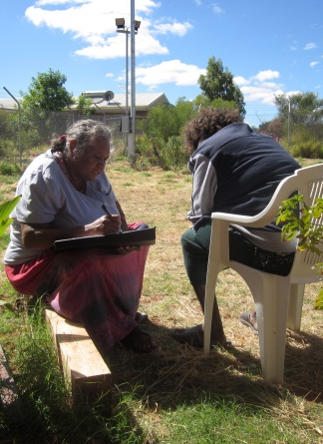
Ada Lechleitner conducting interviews on housing maintenance in Ntaria, NT

Slide 5
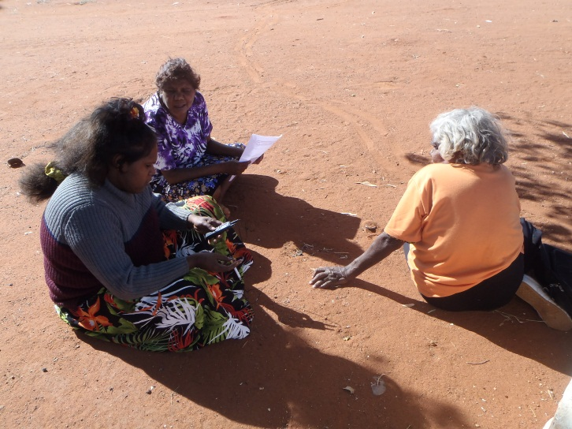
Better support to rough sleepers in a country town in South Australia
Purpose: To help local services connect more effectively with a group of up to 80 people, especially those people who are
hard-to-reach.
Methods:
Semi-structured interviews
Focus groups
Workshop sessions

Slide 6
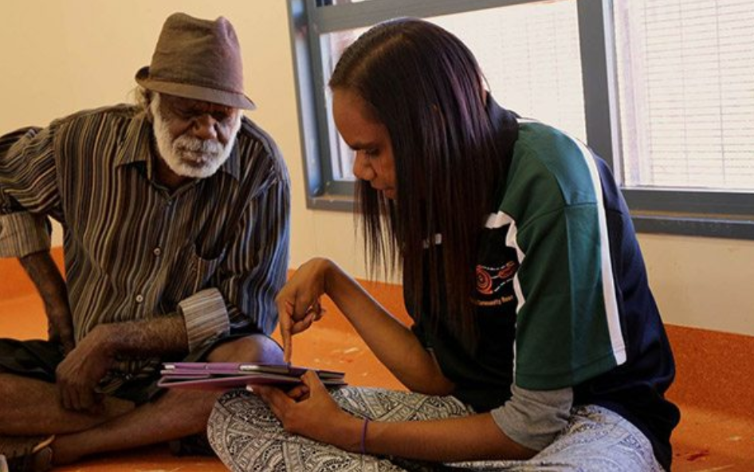

Slide 7
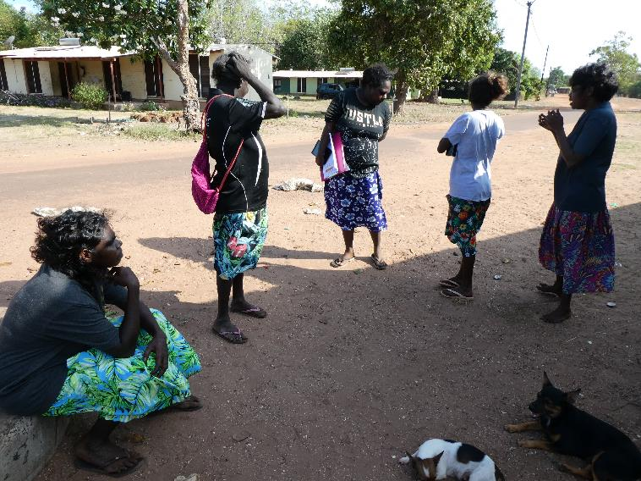
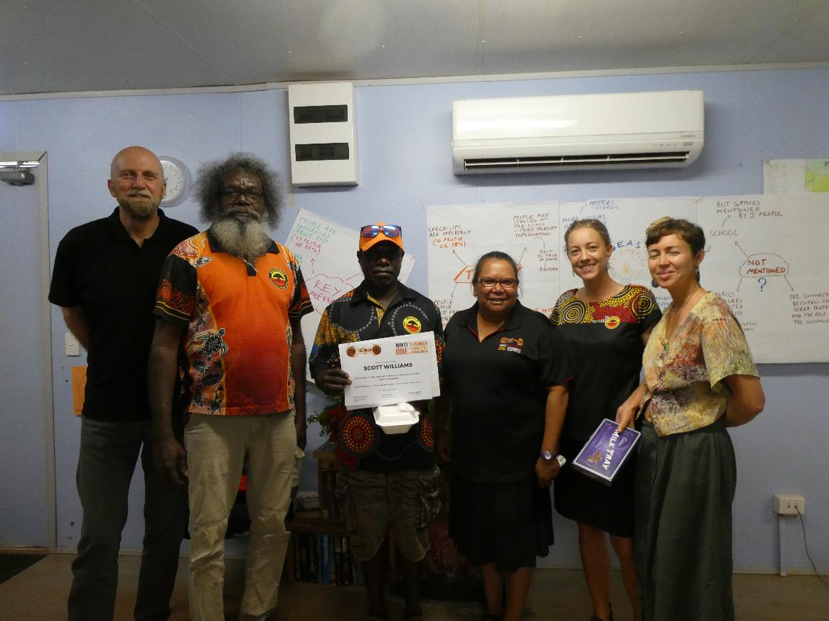
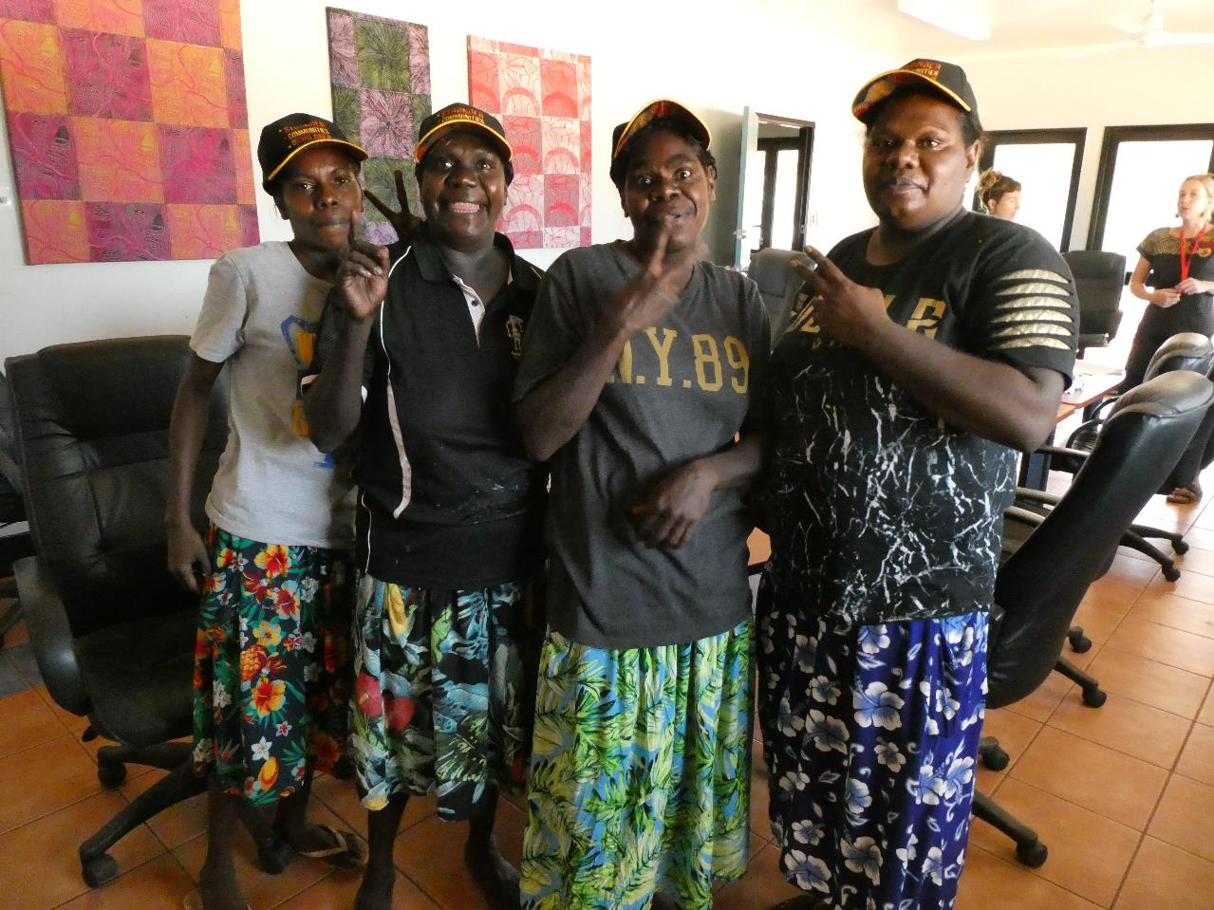
Prevention of Rheumatic Heart Disease in Maningrida, Nov. 2018

Slide 8
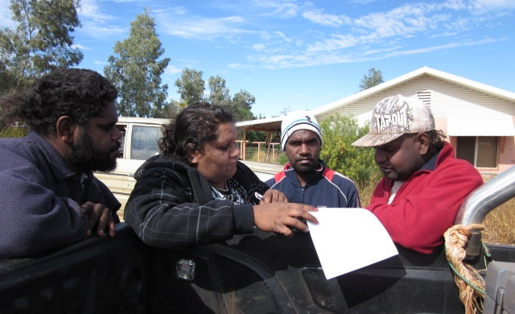
Research on vehicle safety by Ninti One at Ntaria, Northern Territory, 2011 (see Lovell et al, 2011)

Slide 9
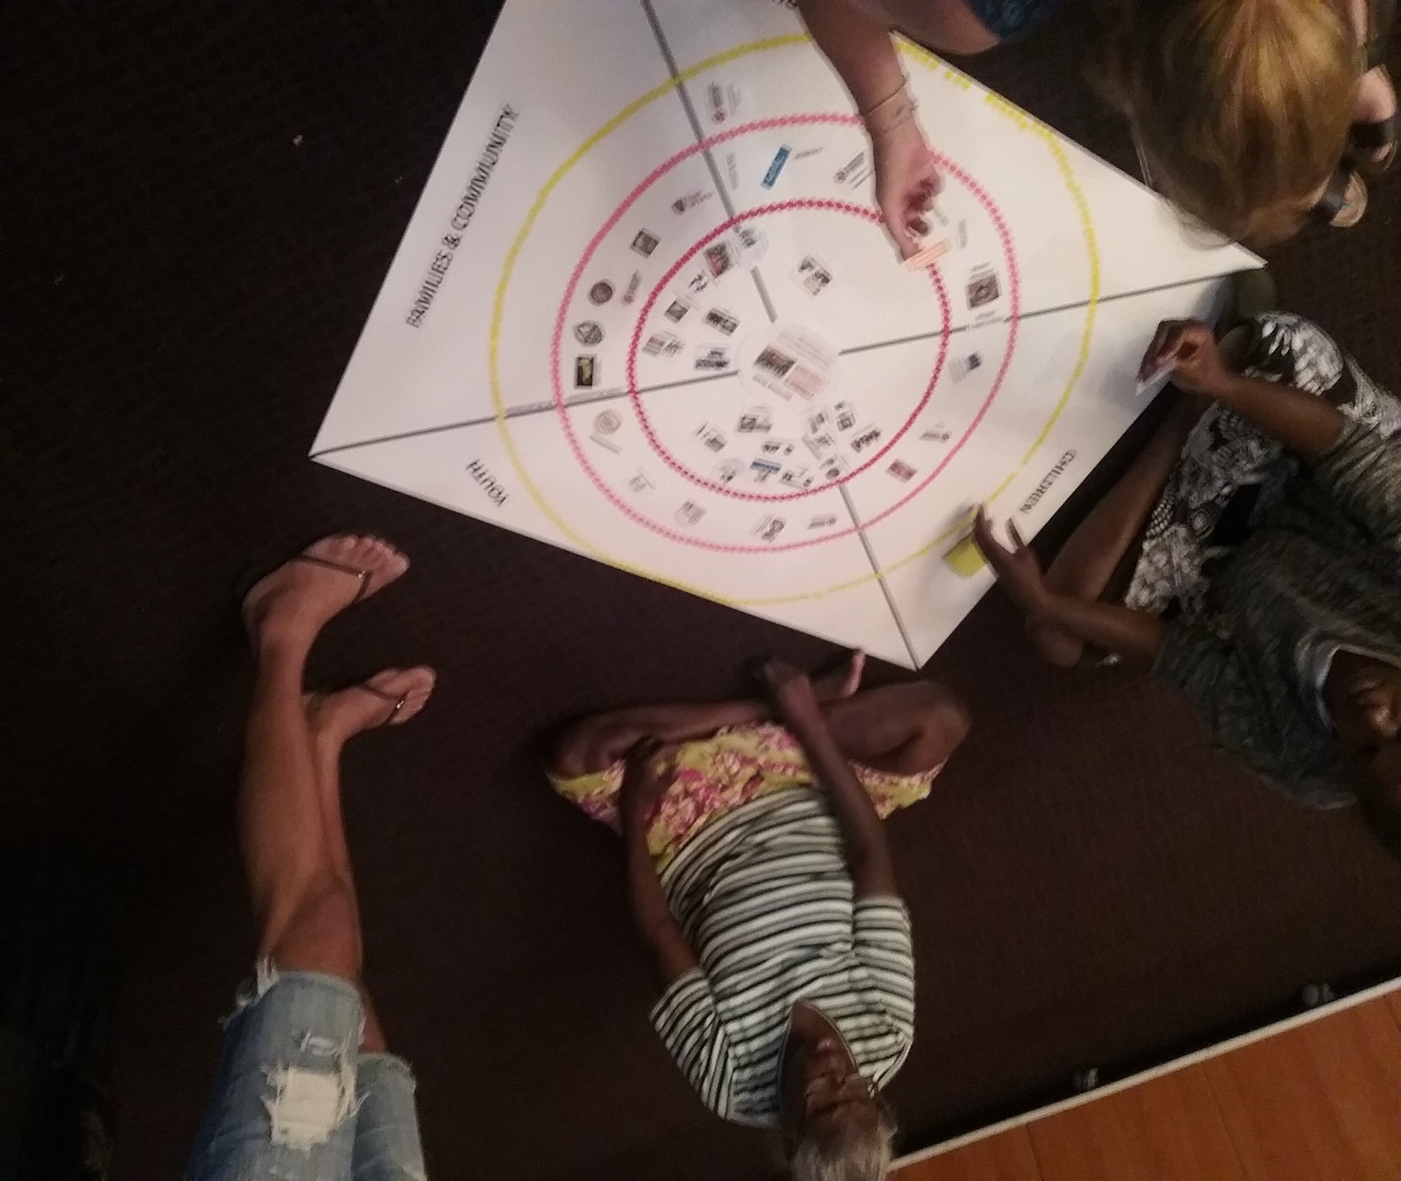
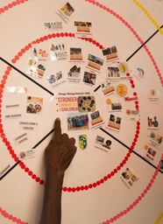
Research to support Collective Impact for Stronger Communities for Children in the NT

Slide 10
How ACRs can help TIS teams
Example: Family Day organised for World No Tobacco Day in Halls Creek, two Fridays ago, 31st May.
The local TIS team of two men from Yura Yungi Aboriginal Medical Service coordinated the event at the main park in town.
Let’s say that 200 people came along, ate lunch, heard some speeches by local pollies and sports players, visited stalls on health promotion, talked to TIS workers, used the smokerlyzer, saw videos on ‘Don’t Make Smokes Your Story’ and listened to a local band.

Slide 11
How ACRs can help TIS teams
Every research project needs one or more high-level research questions. In this case, there could be a single question:
How effective was the Family Day in helping to tackle Indigenous smoking in Halls Creek?
If there were 200 people coming and going during the event, the TIS workers are going to struggle to do the necessary research on their own.
This is where the ACRs come in.

Slide 12
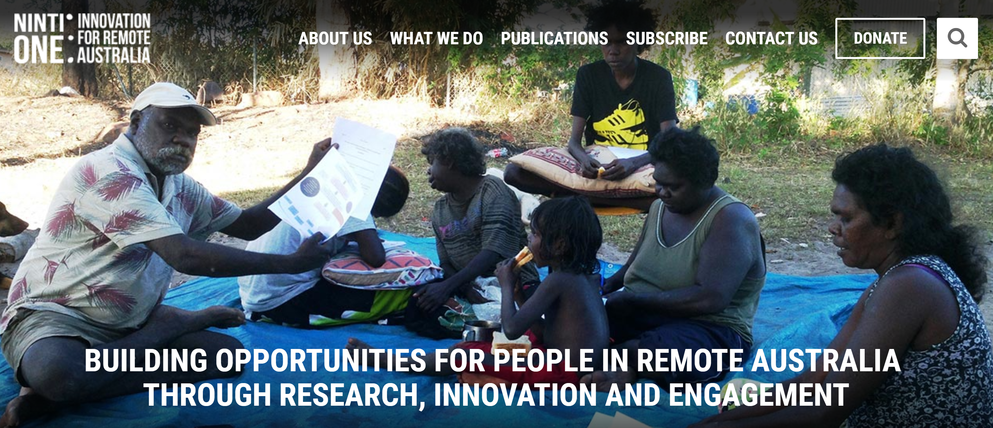
Ninti One website
www.nintione.com.au

Slide 13
Any questions and further discussion

