Slide 1

TIS NBPU WA Regional Workshop 2017
Smoking & Prevention
30 August 2017
Prof Tom Calma AO
National Coordinator Tackling Indigenous Smoking

Slide 2
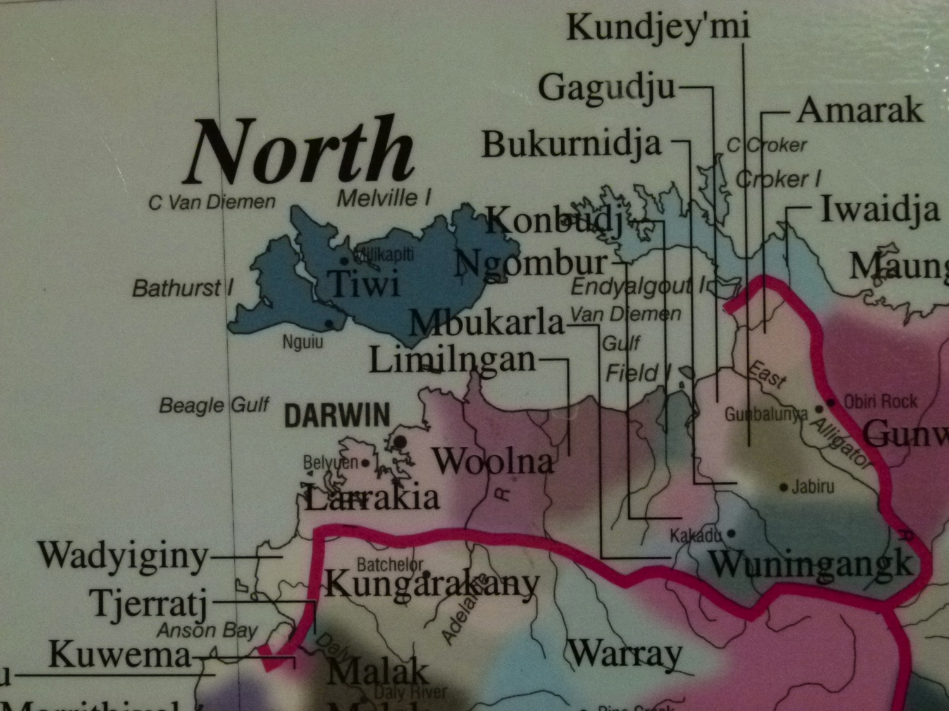

Slide 3
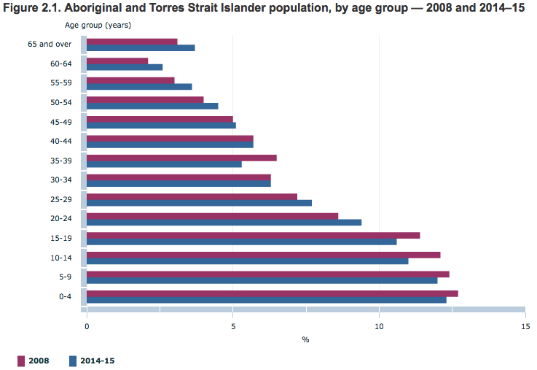
63% < 30yo
46% < 20yo
Notes:
Age structure
The Aboriginal and Torres Strait Islander population is relatively young. In 2014–15, almost two-thirds (63%) of the population was aged under 30 years. Those aged under 20 years comprised 46% of the Aboriginal and Torres Strait Islander population. The population did age somewhat between 2008 and 2014–15, with an increased proportion in 2014–15 of people in older age groups from 45 years and over (Figure 2.1).

Slide 4
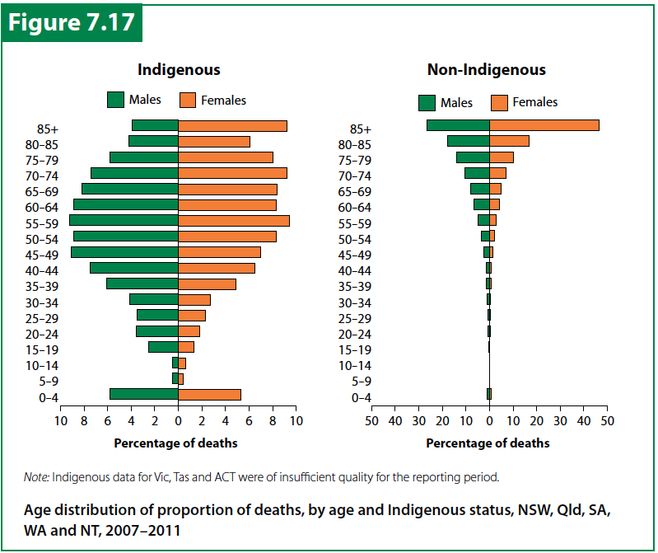
AIHW Australian Health Status Report 2014

Slide 5
Risk of death to age 65, by Indigenous status, Australia 2010
Dead by age 65:
30% Indigenous Australians
9% non-Indigenous
Australians

Slide 6
Broad causes of death
Most common broad causes of death in Indigenous peoples
Australian Institute of Health and Welfare 2015. The health and welfare of Australia’s Aboriginal and Torres Strait Islander peoples 2015. cat. No. IHW 147. Canberra: AIHW.
Notes:
When we look at broad causes of death, Cardiovascular disease is the cause of death for 25% Aboriginal and Torres Strait Islander people………
And…cancer is the second most common broad cause of death among Indigenous people, accounting for one in five deaths, with lung cancer being the most common cause of such deaths (4.9% of all deaths).

Slide 7
Aboriginal and Torres Strait Islander Smoking
Source: ABS Aboriginal and Torres Strait Islander Health Survey 2012-13 *Data for non-Indigenous people are for 2011-12, from the Australian Health Survey 2011-13.

Slide 8
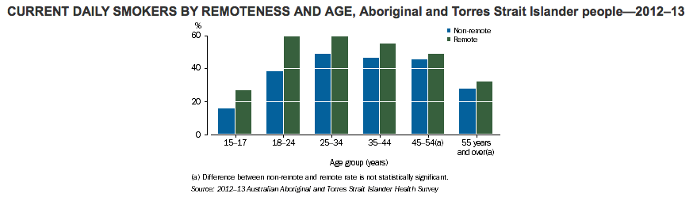

Slide 9
Aboriginal and Torres Strait Islander Smoking
39% NATSISS 2014/15
COAG 2018 target
Source: ABS Aboriginal and Torres Strait Islander Health Survey 2012-13

Slide 10
COAG CTG Targets
Professor Ian Anderson AO – Deputy Secretary PM&C
  Portfolio and community consultations to inform target setting
DoH – Indigenous Health Division sponsoring a multi – disciplinary team to consider the NATSIHPIP from a social and cultural determinants perspective – reporting in September 2017
Redfern Statement – Indigenous priorities
Distractions – statues, 26 Jan, referendum & treaties

Slide 11


CTG Refresh - time for change
Closing the Gap a national strategic priority.
COAG to consider refreshed agenda by end 2017.
Progress in many areas, but political and community sense that we need to do better.
Guide $300 billion investment over next decade.
Collaboration and partnership, a new way of working together.
“While governments have a critical role in setting policies and implementing programs, true gains are made when Aboriginal and Torres Strait Islander people are able to work with governments to set the agendas that impact on their wellbeing.”
Prime Minister, 2017 Closing the Gap Report
Notes:
As you know, next year marks the tenth anniversary of Closing the Gap.
Through COAG, all governments have reaffirmed that improving the lives of Indigenous Australians is a strategic priority for the nation, and have agreed to consider a refreshed framework, targets and implementation principles for the Closing the Gap agenda by the end of the year.
Over the last ten years, progress has been made in several areas of Indigenous disadvantage.
However, despite good intentions and significant investment, progress has been too slow.
There is a shared sense among Indigenous leaders, governments and the wider community that we need to do better for Aboriginal and Torres Strait Islander individuals, families and communities.
As the overarching strategic framework for Indigenous Affairs in this country, the refreshed CTG agenda will guide investments by all governments on programs and services for Indigenous Australians of around $30 billion per year, or $300 billion over the next decade.
But we know that money alone won’t solve persistent Indigenous disadvantage. As the quote from the Prime Minister highlights, government also recognises that the next phase of Closing the Gap requires a new way of working with Indigenous Australia.
A way of working that brings Indigenous leaders and communities into the tent in genuine collaboration and partnership with government, both in the development and implementation of local and meaningful solutions on the ground.

Slide 12
Redfern Statement - Key commitments sought
Commit to resource Aboriginal and Torres Strait Islander led-solutions,
Commit to better engagement with Aboriginal and Torres Strait Islander peoples through their representative national peaks,
Commit to addressing the unfinished business of reconciliation,
Recommit to Closing the Gap in this generation, by and in partnership with COAG and Aboriginal and Torres Strait Islander people:
Setting targets and developing evidence based, prevention and early intervention oriented national strategies which will drive activity and outcomes addressing:
  family violence (with a focus on women and children);
  incarceration and access to justice;
  child safety and wellbeing over-representation in out-of-home care; and
  increasing Aboriginal and Torres Strait Islander access to disability services

Slide 13
NATSISS 2014 / 15
The proportion of Aboriginal and Torres Strait Islander children aged 0–14 years who were living in a household in which there was at least one daily smoker was 56.7% in 2014–15, down from 63.2% in 2008 (Table 8).
About six in 10 (60.3%) Aboriginal and Torres Strait Islander people aged 15 years and over were living in a household in which there was at least one daily smoker in 2014–15 (Table 16), down from 67.5% in 2008.
In 2014–15, the proportion of Aboriginal and Torres Strait Islander people aged 15 years and over who were daily smokers was 38.9%, down from 44.6% in 2008 and 48.6% in 2002. Between 2002 and 2014–15, there was a significant improvement in non-remote areas (down 11.4 percentage points) (Table 1).
Notes:
Galiwinku and East Arnhem Land smoke free homes initiative. Deck chairs and mats for each house with a sign out the font saying a smoke free home – for our future.

Slide 14
The Old TIS Programme
TIS Teams hosted by orgs
Smoking cessation and healthy lifestyle
Referral to smoking cessation support
Population health approach
NCTIS
Quit Skills support
Quitline enhancement
Regional Tobacco Fund
National Office provided policy advice and some grant funding
Managed other chronic disease programmes

Slide 15
The New TIS Programme
Grant Recipients (GR)
Whole of service approach – population health + smoking cessation
Greater discretion to GR – outcomes focused
Smoking cessation and healthy lifestyle
No healthy lifestyle funded
NCTIS
Quit Skills support & Quitline enhancement
Dedicated TIS policy section at national office – amalgamated in March 2017 – Preventive Health & Renal Policy Section
Grants Services Division - Health State Network (HSN)
NBPU
Evaluation Framework
Notes:
Just a quick overview and details in the next slide
Highlighted text those elements that transferred from the old TIS

Slide 16
What is Tackling Indigenous Smoking initiative?
National Coordinator Tackling Indigenous Smoking
National Best Practice Unit
Grants – 37 orgs funded (GRs) – national coverage
Evaluation Framework
……………………………………………………………………………………………………………………………………………………………………………….
Quit skills training
Quitline enhancement
Targeted / Innovation projects – pregnant mothers, youth and remote
New NBPU initiatives – videos & leaders workshops
Notes:
TIS is more tan just the teams.
Also mention state and territory govt strategies and initiatives
Work of other areas of the DoH including mainstream Tobacco and Communications branch ie “don’t make smokes your story”.
Quitskills – three day course on brief interventions
Alternative: David Copley – one day training - Awabakal training all of their staff and are shutting down all of their operations over two days. Half staff in Day One and other half in day two.
Quitskills enhancement - Gippsland and QUIT Vic alliance.

Slide 17
Innovation Grants 2016/17
The innovation projects have now commenced. The projects are as follows:
Aboriginal Males Shedding the Smokes - Aboriginal Health Council of South Australia Inc.
Growing a smoke-free story - Metro South Hospital and Health Service, Queensland Health
The Top End Smoke-Free Spaces Project - Aboriginal Resource and Development Services Aboriginal Corporation (ARDS)
Smoking, Nutrition, Alcohol and Physical Activity ‘SNAP’ - National Drugs and Alcohol Research Centre, University of New South Wales
The Balaang and Binjilaang Aboriginal Women Tobacco Intervention Project - South Coast Women’s Health & Welfare Aboriginal Corporation
Growing the Smoke Free Generation - Northern Territory Department of Health
Tackling Indigenous Smoking Innovation Grant Project - Western Australian Centre for Remote and Rural Medicine Ltd (The project will use a women-centred approach to achieve a better understanding of Aboriginal women’s barriers to smoking cessation)
http://www.health.gov.au/internet/main/publishing.nsf/Content/indigenous-tis-innovation-grants
Notes:
Research the project in your state to see if you can input and also learn.
Maybe in future might be more projects subject to funding.
We will upload progress report as we receive them.

Slide 18
NBPU initiated and supported initiatives
HealthInfoNet TIS Portal
NBPU TIS website
Social media accounts
Mailing list/ register protocols
eNews
Promotion strategy
Performance monitoring, analysis and reporting systems in association with program evaluators

Slide 19
Impact assessment, performance indicators and data collection and reporting on results
To enable GRs to adopt evidence-based and results-oriented approaches in order to reduce rates of smoking among Indigenous people
Monitoring and Evaluation framework and program performance indicators
Third year of funding for grant recipients relies on evaluation results for first 2 years. Reported in March 2017 – got it – NOW FOR 2018 ++ FUNDING
Notes:
NBPU through Penney Upton doing training on data collection, monitoring and reporting.
CIRCA doing the evaluation of the TIS programme to report to the department.

Slide 20
National Indicators
Quality and reach of community engagement
Organisations involved in tobacco
reduction in the region
Building capacity to support quitting
Referrals to appropriate quitting support
Supporting smoke-free environments

Slide 21
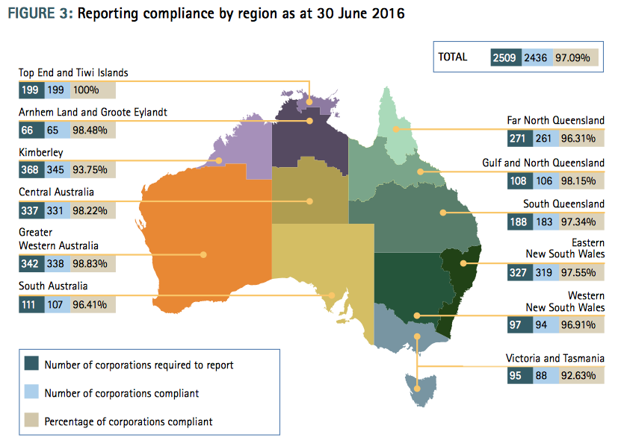
ORIC
Yearbook
2015/16
Pg 17
Notes:
If each organisation had a smoke free policy then we would make a significant impact.
Also orgs and companies register under state and territory orgs and ASIC or church groups with high Indigenous populations

Slide 22
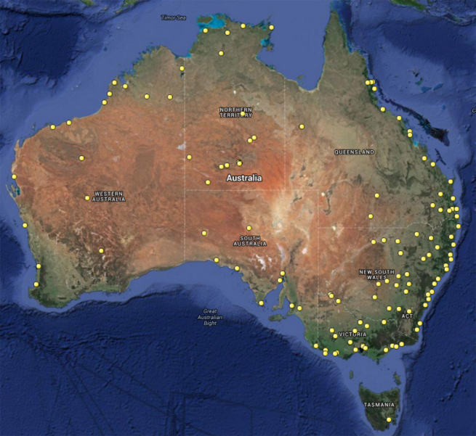
NACCHO
140+ member orgs
TIS
37 Grant Recipients
Other providers
Clinical
Pop Health teams
NGOs
http://www.naccho.org.au/member-services/www-what-where-when-in-aboriginal-health/
Notes:
37 GRs to service 140+ AMS therefore each GR will service a number of AMS in their service area.
Many ACCOs and NGOs to work with for both staff and clients

Slide 23
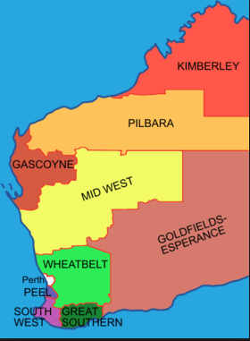
Do services cover the whole of WA?
Does your service coverage comply with your funding agreement?
Where are the gaps and how do we service the gaps?

Slide 24


Targeted sports social media campaigns

Slide 25

Leveraging the mainstream

Slide 26
What do we need to focus on?
Evaluation findings
Demonstrate reach
Demonstrate impact
Demonstrate community buy-on
Demonstrate responsiveness and resilience

Slide 27
Quick Runs
Smoke free workplaces
Local events
Commonwealth, State / Territory & Local Politicians
Media engagement
Uploading to the TIS Portal
Contracting / engaging support to achieve outcomes – NBPU ACR team

Slide 28
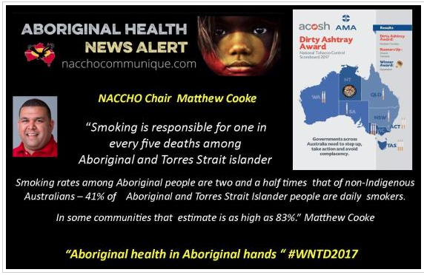
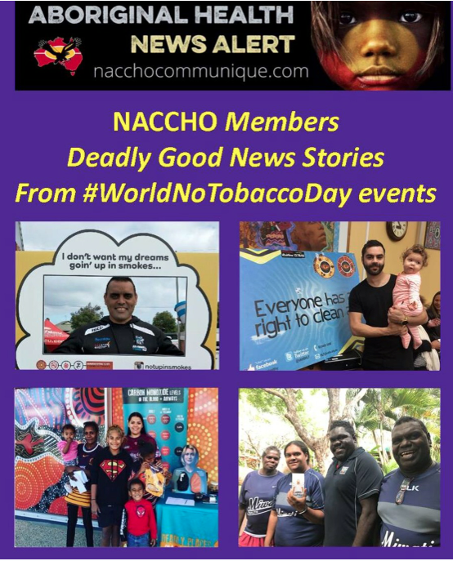
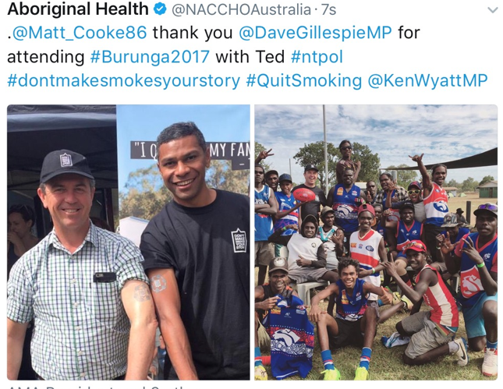

Slide 29
Good News Messages for the portal
“Well here are my stats. 365 days no boondahs - $7,306 saved. This time last year I was very sick in hospital.”
“My wife and I used to smoke a pack of 30s between us every day. After we quit smoking we put all of the money we didn’t spend on smokes into a savings account. After 18 months we had saved about $14,000, which paid for half of the deposit on our investment property.”

Slide 30
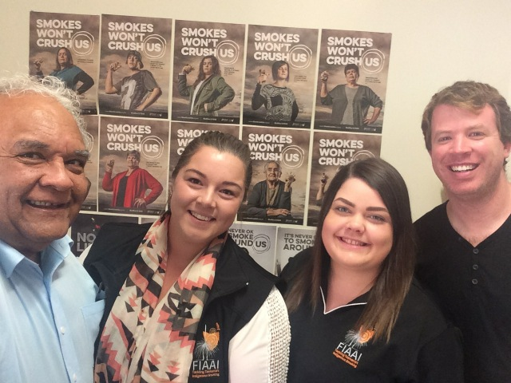
NCTIS visits and uploading to the TIS Portal

